Slide 1
HOT&COLD
CSE101 TERM PROJECT

Slide 2
MEMBERS
Beyzanur YILMAZ
Eren ÖZER
Furkan DURSUN
İsmail Emir AYVAZ
Mehmet Alp ATAY
Muhammet Batuhan ALTUN
Oğuz AKKUŞ
Osmancan BOZALİ
Semih DERVİŞ
Tuğrul GÜRSES

Slide 3
INTRODUCTION

Slide 4
AIM OF THE PROJECT
As a team, we decided to make a game called “Hot&Cold” after two appointments.
Aim of the project was make fun and create an original and unique project while do some collabretive work as a team.

Slide 5
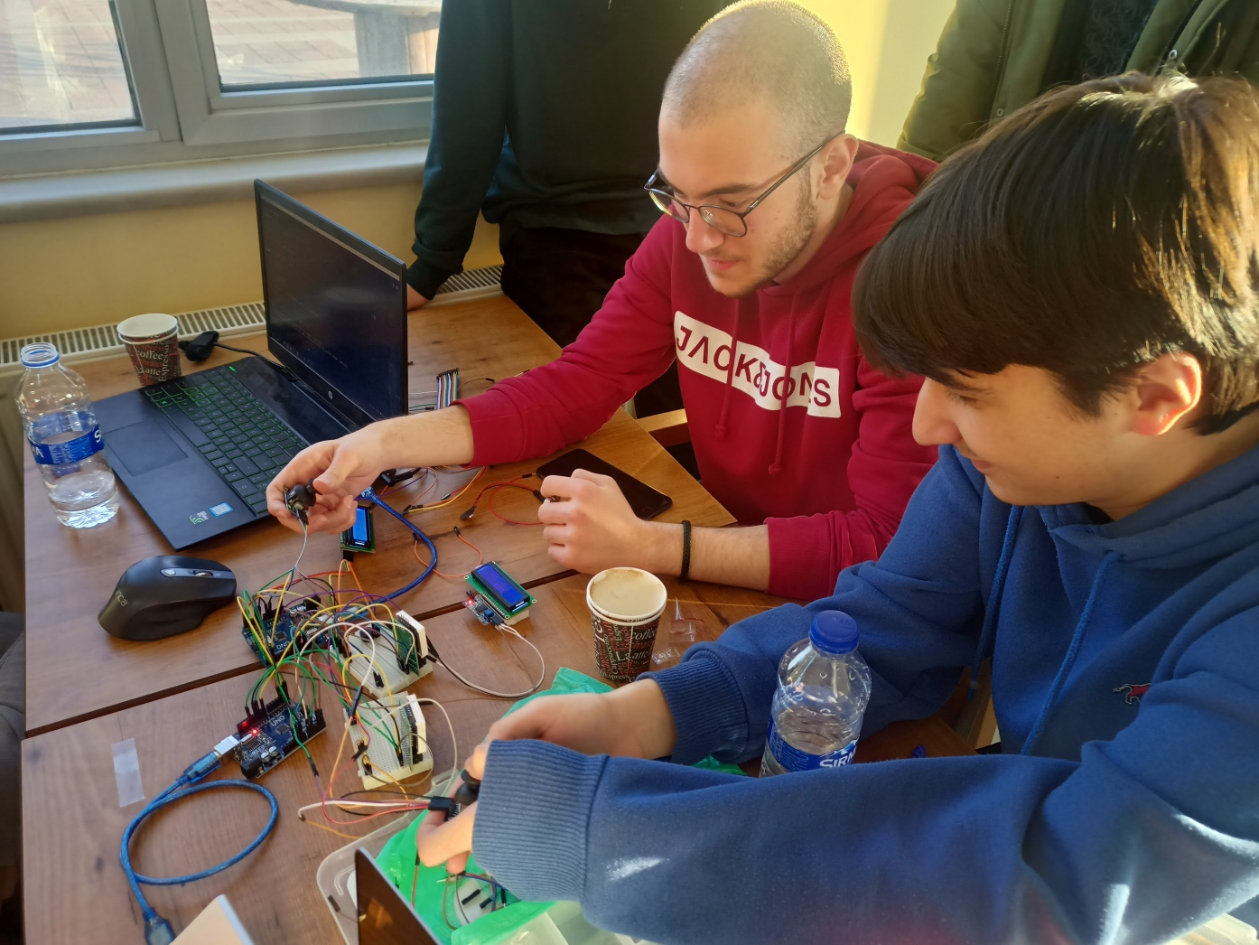
GAME PLAY

Slide 6
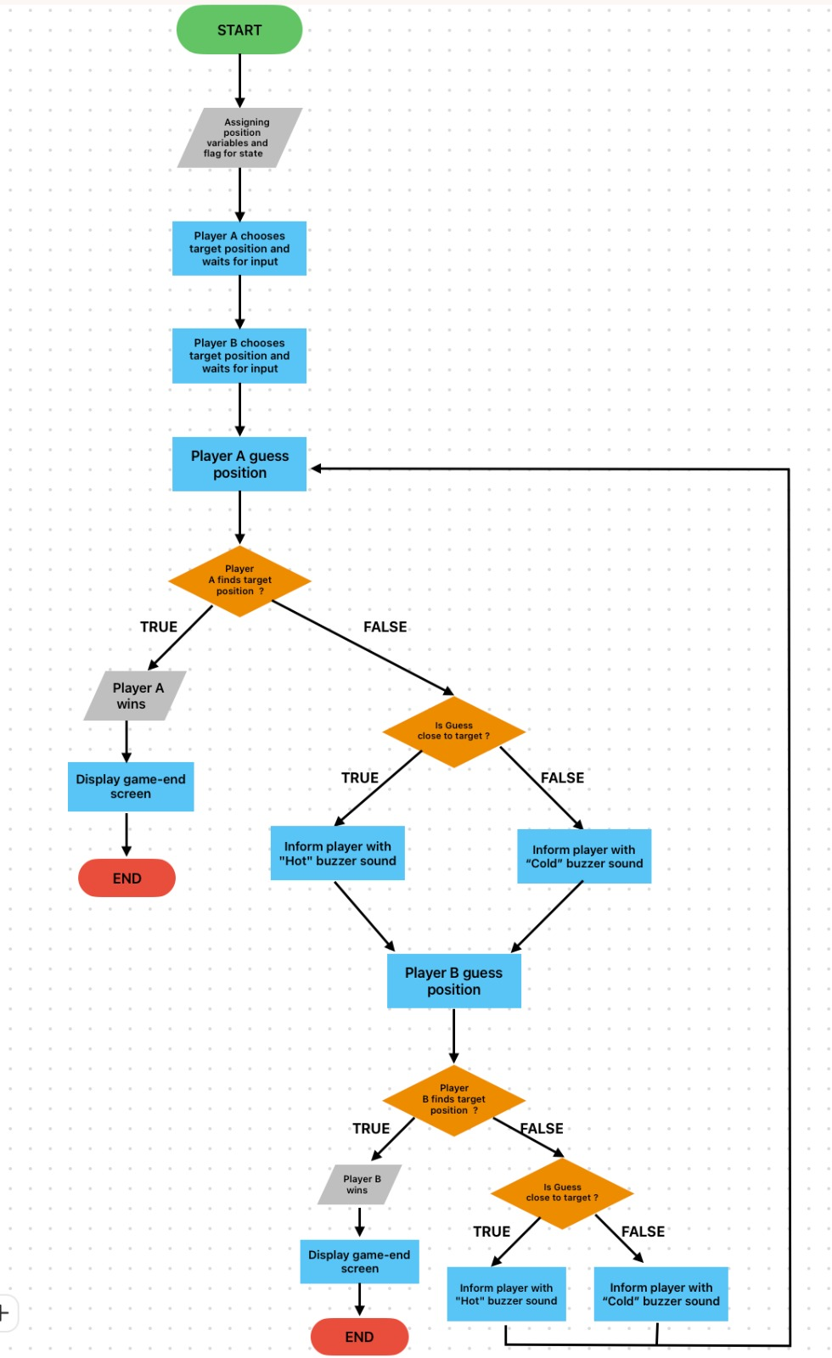
FLOWCHART

Slide 7
SOFTWARE

Slide 8
COMMUNICATION BETWEEN ARDUINOS
void loop()
{
// TEST for state value (single variable)
//int state = 0;
Serial.println("STATE VALUE TEST");
Serial.println("Initial State Value: " + String(state));
Serial.println("Please insert new state data: ");
getData(1,&state); // func
Serial.println("New State Value: " + String(state));
Serial.print("Sending State data as: ");
sendData(1,&state); // func
delay(500);
// TEST for position values (2 variables)
//int x_pos =0, y_pos=0;
Serial.println("POSITION VALUE TEST");
Serial.println("Initial Position Values --> X_POS: " + String(x_pos) + " Y_POS: " + String(y_pos));
Serial.println("Please insert new position data: ");
getData(2,&x_pos,&y_pos); //func
Serial.println("X_POS: " + String(x_pos) + " Y_POS: " + String(y_pos));
Serial.print("Sending position data as: ");
sendData(2,&x_pos,&y_pos); //func
delay(500);
// TEST for 3 variables
//int first=0, second =0, third=0;
Serial.println("TEST FOR 3 VARIABLES");
Serial.println("Initial Values --> First: " + String(first) +" Second: " + String(second) + " Third: " + String(third));
Serial.println("Please insert 3 one digit numbers without space");
getData(3,&first,&second,&third);
Serial.println("First: " + String(first) +" Second: " + String(second) + " Third: " + String(third));
Serial.print("Sending data as: ");
sendData(3,&first,&second,&third);
delay(1000);
Serial.print("\n\n\n\n\n\n");
}

Slide 9
FUNCTIONS
void loop()
{
intro();
getPixel();
pixelSelection();
findPixel();
wait();
gameOver();
backToStart();
}

Slide 10
HARDWARE

Slide 11
EQUIPMENTS
2x 16x2 LCD
2x I2C MODULE
2x JOYSTICK
2x 8x8 Dot Matrix LED
2x Arduino Uno
2x 9V Battery
+500 g Filament ( for 3D printer )

Slide 12
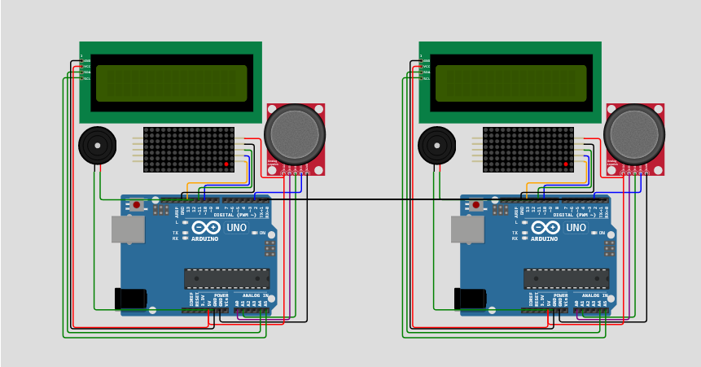
CIRCUIT DESİGN

Slide 13
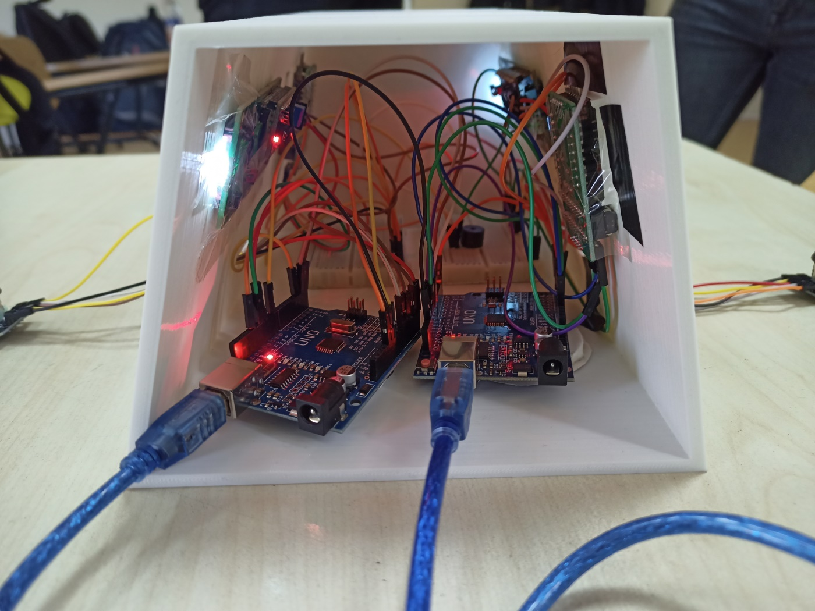
CIRCUIT

Slide 14
DESIGN

Slide 15
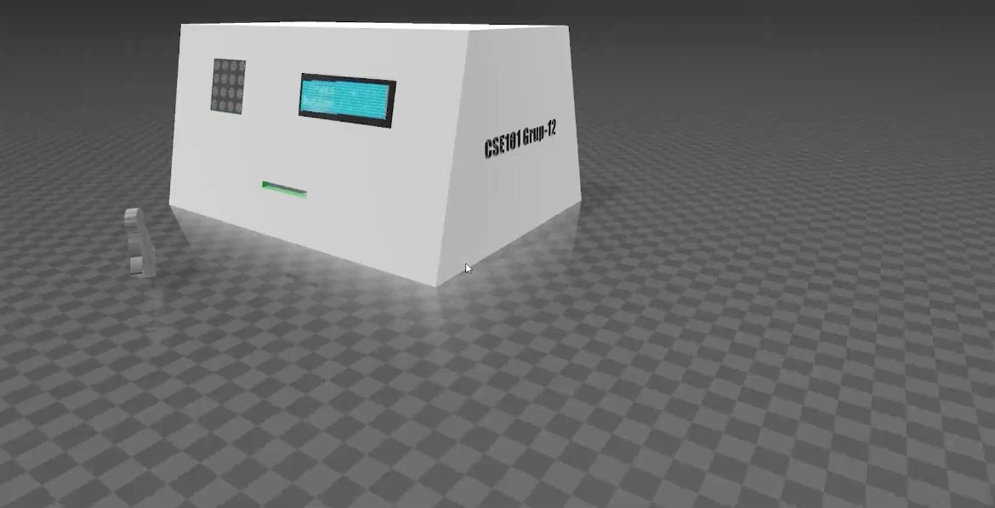
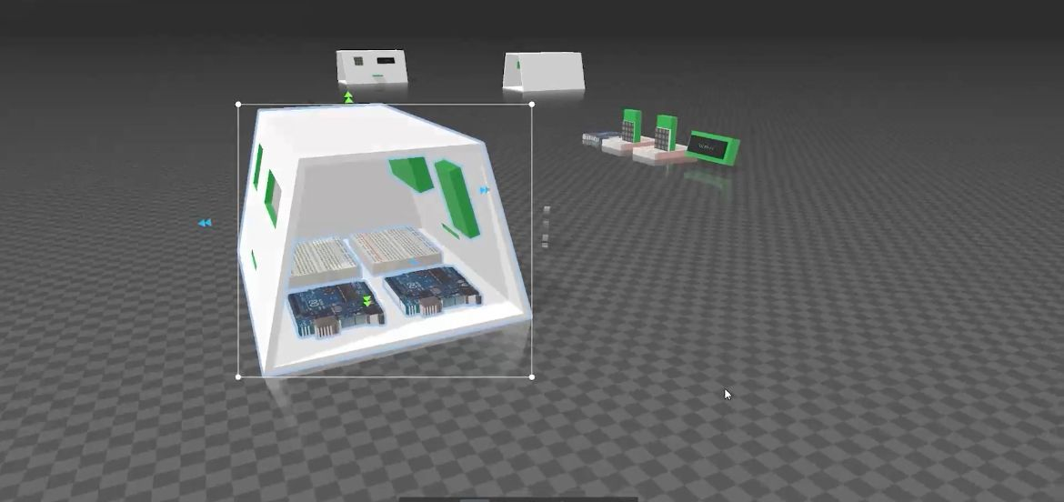
BOX SKETCH
We used 3D Builder for designing the box. 3D Builder lets you create and print your own 3D models.

Slide 16
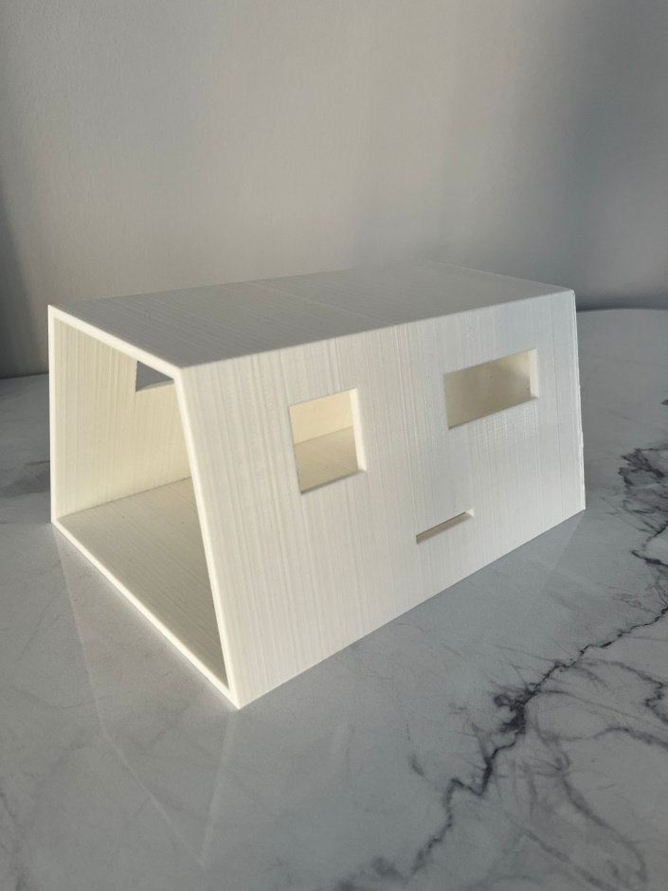
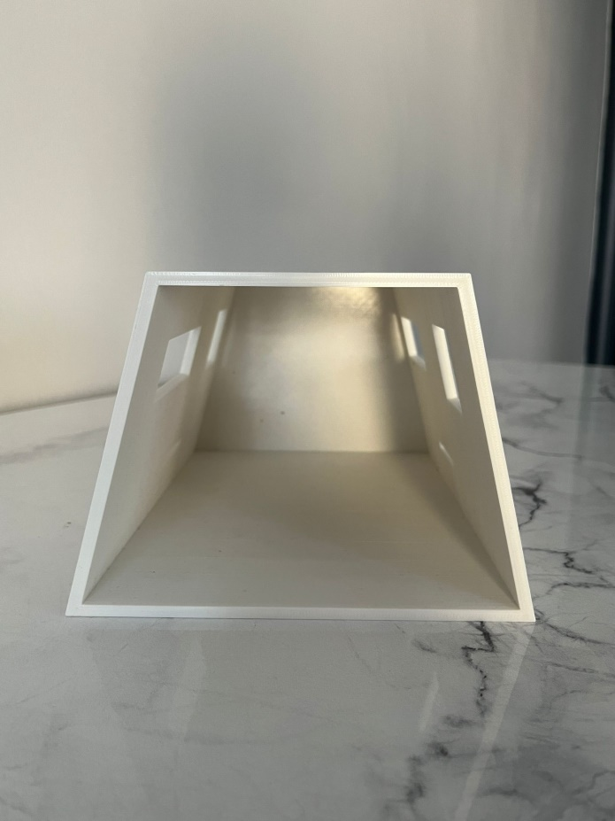
LAST PRODUCT

Slide 17
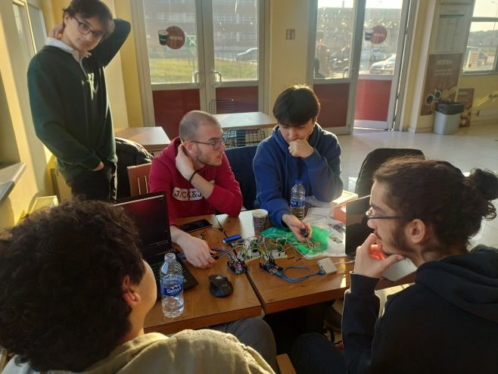
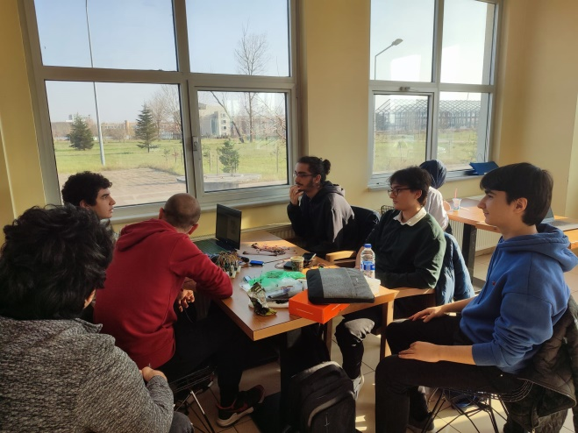
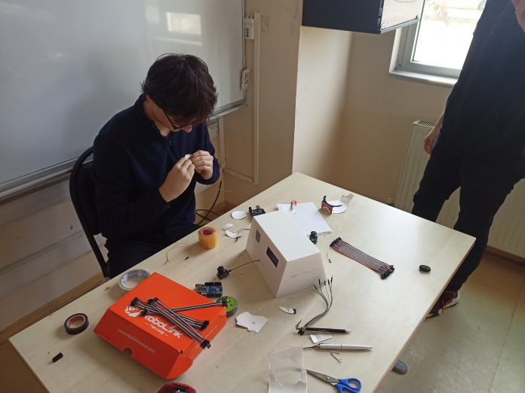
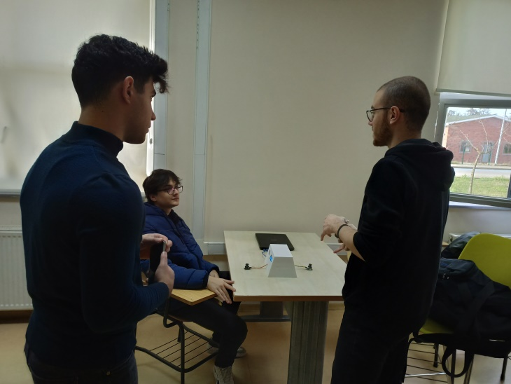
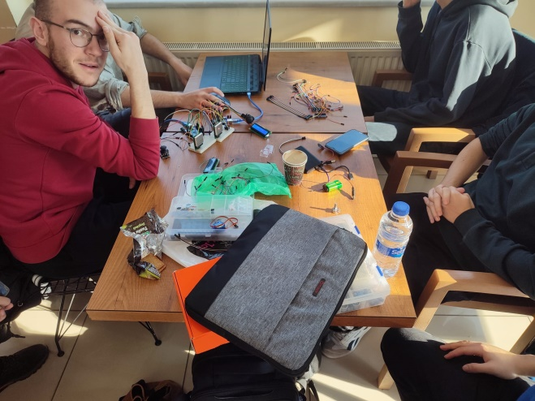
PHOTOS

Slide 18
SOURCES & REFERENCES
https://github.com/MajicDesigns/MD_MAX72XX/tree/main/examples
https://wokwi.com/
https://www.electroniclinic.com/serial-communication-between-two-arduino-boards/

Slide 19
THANK YOU FOR LISTENING US.

